Slide 1
impute
impute
Journal club
Jan 2023

Slide 2
Developmental research specific
So many free resources!!

Slide 3
Other references
van Buuren S, Groothuis-Oudshoorn K (2011). “mice: Multivariate Imputation by Chained Equations in R.” Journal of Statistical Software, 45(3), 1-67. doi:10.18637/jss.v045.i03.
Azur, M.J., Stuart, E.A., Frangakis, C. and Leaf, P.J. (2011), Multiple imputation by chained equations: what is it and how does it work?. Int. J. Methods Psychiatr. Res., 20: 40-49. https://doi.org/10.1002/mpr.329
Graham JW. Missing data analysis: making it work in the real world. Annu Rev Psychol. 2009;60:549-76. doi: 10.1146/annurev.psych.58.110405.085530. PMID: 18652544.
'Best Practices for Addressing Missing Data through Multiple Imputation.' https://osf.io/j3f8m/
'Missing Data and Multiple Imputation Decision Tree.' https://osf.io/preprints/psyarxiv/mdw5r

Slide 4
Disclaimers
You may have some statistical questions that are beyond the scope of me
I am not a statistician
I am doing my best

Slide 5
Take home/overview
A common challenge in developmental research is missing data due to incomplete tasks, attrition, etc.
Handling missingness through typical deletion/default methods can lead to biased results
Multiple imputation is easy to implement and can help address bias due to missingness

Slide 6
How missing data are commonly handled
By default, many people handle missingness by doing listwise deletion or many packages in R (such as lme4) handle missingness with pairwise deletion
However, handling missing data in these ways may only be acceptable when 1) you are missing less than 5% of your data or 2) data is missing completely at random (Graham, 2009)

Slide 7
Multiple imputation
Can reduce the impact of data loss and attrition by using the information that is available to approximate what results would look like if data were complete
Reduce bias and sample size concerns!
More reproducibility!
But before we talk about how to implement it and what its doing, let's talk about some common misconceptions

Slide 8
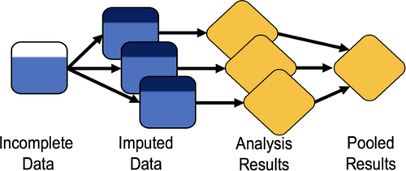
But Maria, isn't imputation just making up data?
Not really. The logic of imputation is really similar to the logic of regression: given a set of predictors, estimate what the missing values are likely to be.
MI algorithms use your available data to optimize the missing data predictions
Doing multiple imputations so you arrive at robust estimates and account for statistical uncertainty
Point estimates are pooled to provide one overall estimate

Slide 9
But shouldn't we only impute if data is missing at random?
You should try to understand why your data is missing (or why you think it is missing) as this has different implications for generalizability and ignorableness
Missing completely at random (MCAR): data are missing as a result of a truly random process
Examples: random missingness by design such as different participants receiving random subsets of scales to minimize overall participant burden; a truly random technical issue arises
This missingness is safe to 'ignore' because estimates are still unbiased
Proving that your data is MCAR is almost impossible unless it was planned

Slide 10
But shouldn't we only impute if data is missing at random?
Missing at random (MAR): missing data are missing in a systematic way that can be accounted for with available data
If this is the case, missingness should be addressed with imputation
Example: a participant's SES predicts whether or not they return back for a visit 2, and you have collected SES data
Missing not at random (MNAR): missingness that cannot be fully accounted for with other variables in the dataset
Example: a participant in a clinical trial with worse side effects from a drug is less likely to come back for follow up visits because they feel really sick. Therefore your final analysis will end up under-estimating drug side effects.
Here, you don't have the information you need for MAR but sample is biased in ways that impact conclusions
If this is the case, imputation may still be a little helpful with some auxillary info & could produce less biased estimates than not having that data at all

Slide 11
But shouldn't we only impute if data is missing at random?
Most times, data missingness can be a combination of these reasons and can likely be at least partially accounted for if you've collected additional information about participants
However... you will never actually know why your data is missing
Should discuss hypothesized patterns of missingness & justify MCAR/MAR/MNAR in your manuscript

Slide 12
If data are not missing completely at random, default deletion methods lead to biased results, lack of generalizability, decreased statistical power, and less reproducible results.
Missing Data and Multiple Imputation Decision Tree
https://osf.io/preprints/psyarxiv/mdw5r

Slide 13
Can I still impute if I have a small sample or I am missing lots of data?
MI performs well in small samples (has been tested as low as n=50; Graham & Shafer, 1999)
MI performs well even when 50% of data is missing for a variable (Graham, 2009)

Slide 14
But surely there is some data we should never impute right?
Not really
No actual reason to think any type of data (brain, behavior, etc.) should not be imputed
Can impute outcomes and predictors, continuous or categorical variables, etc.
Some possible ethical concerns for imputing missing demographic data
Example: if survey response asks for gender and has only M or F, participant may have declined to respond because they don't identify as M or F

Slide 15
Ok but I haven't seen a lot of papers in our field doing this
No but they probably should

Slide 16
This seems complicated and like a lot of extra work
It's really not that bad. R makes it easy.
Allow me to demonstrate

Slide 17
An overview of the steps
Explore data missingness and develop MCAR/MAR/MNAR hypotheses
Consider what auxilliary variables can be included in the imputation model
Specify imputation model
Run multiple imputation by chained equations
Check to make sure it worked
Missing Data and Multiple Imputation Decision Tree
https://osf.io/preprints/psyarxiv/mdw5r

Slide 18
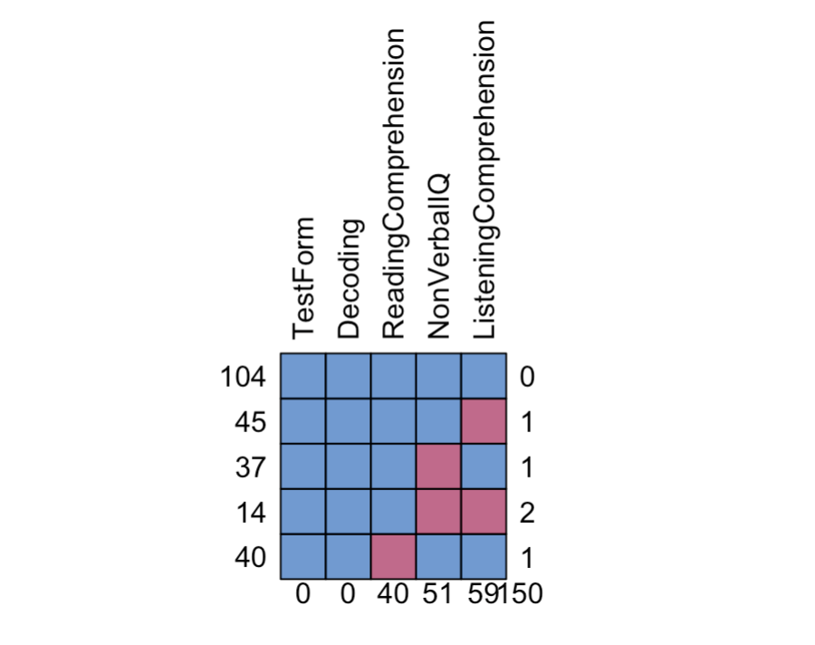
Step 1: explore data missingness
mice::md.pattern()
Each row is 1 pattern of missingness
Blue: observed data
Red: missing data
Number on the left: number of observations that have this pattern
Number on the right: number of variables missing in that pattern
Bottom row: number of datapoints missing for that variable
Bottom right corner number: total number of missing data points
Notes:
104 people have no missing data in any of these measures
45 people have missing listening comprehension data
14 people have both missing nonverbal IQ and listening comprehension data
Across the whole dataset there are 150 missing data points total

Slide 19
Step 2: test auxiliary variables
Decide on what is going to be your cutoff – p values, effect sizes
Create a dummy variable that represents whether your variable of interest is missing or not (missdummy = 1, missdummy=0)
Predict it with auxiliary variables that you hypothesize could explain your missingness
Examples: parent education, income to needs ratio, disability status, etc.
If your cutoff is reached, this variable should be included as auxillary variable in your imputation model
Repeat for all predictors & outcomes of interest in analysis
Note: no real downside to including lots of auxillary variables if they turn out to be related (except possibly model convergence issues)

Slide 20
Step 3: Set up data and build imputation model
Create a dataset that includes variables of interest and axuillary variables
For nested data, create multilevel imputation model
Whatever is included in the analytic model must be in the imputation model (interaction terms, random intercepts, random slopes, etc)
Choose number of imputations
impute based on highest fraction of incomplete cases (Graham et al., 2007)

Slide 21
Step 4: run multiple imputation by chained equations (MICE)
MICE is a particular multiple imputation technique considered gold-standard
Operates under assumption that data are missing at random (missingness can be explained by observed values)
R package 'mice' makes this very easy to implement
But what is it doing?

Slide 22
What is multiple imputation by chained equations?
Using observed data & the relationships between the observed data to filling in missing values multiple times, creating multiple "complete" datasets
A series of regression models are run whereby each variable is modeled conditional upon other variables in the specified model
Mice is very flexible and can handle lots of different data types (continuous, categorical, etc.)
Predictive mean matching: uses a linear regression model for continuous missing data, logistic regression for binary data, and multinomial logistic for categorical

Slide 23
MICE steps
Step 1: After you have specified your imputation model, the observed values for the variable with missing data are regressed onto the other variables in the imputation model
Step 2: missing values for variable being imputed are then replaced with predictions or imputations from the Step 1 regression model
Step 3: Steps 1 and 2 are then repeated for each variable with missing data in the imputation model
Step 4: Steps 1, 2, and 3 are then repeated for the number of iterations you specify

Slide 24
Sample code
https://osf.io/cjufh

Slide 25
Step 5: check to make sure it worked!
Check for proper model convergence
Look at descriptive stats – does the imputed data make sense?
Can visually compare imputed & non-imputed data ('mice' package has some tools for this)
https://osf.io/cjufh

Slide 26
Conclusions
You should probably impute your data
It could help with bias, power, and reproducibility
It is not going to be worse than default methods
It is not that hard

